Slide 1


Future of SE Research:
Research for SE,
SE for Research
tim.menzies@gmail.com
http://menzies.us
October 2015
Slides: tiny.cc/gale15

Slide 2

Roadmap
Increasing use of “discover” software tools
Systematic errors in the “discover” software
Next gen software tools to reduce those errors
Prelim results

Slide 3
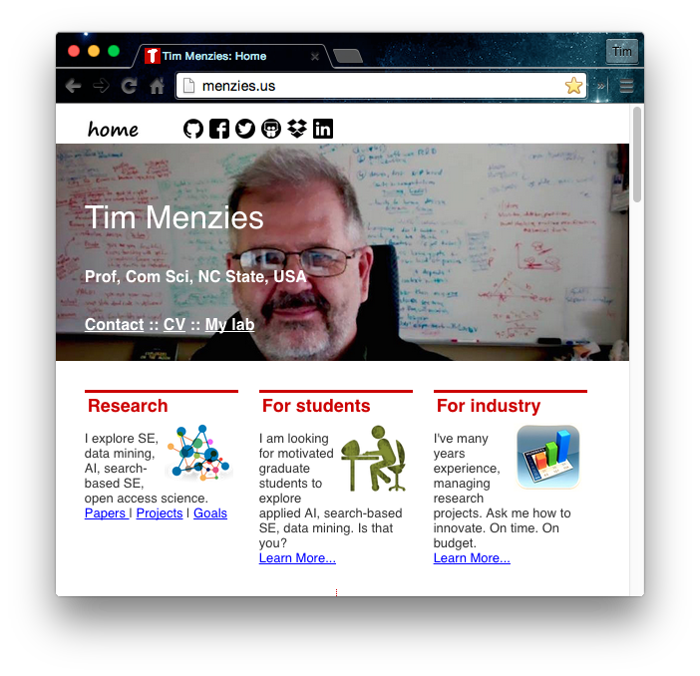
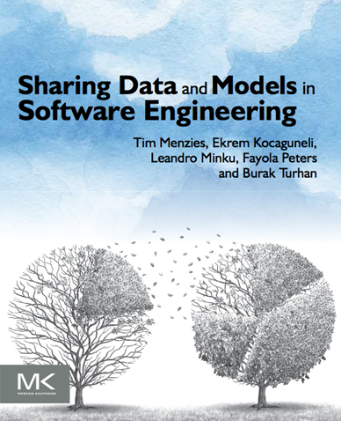
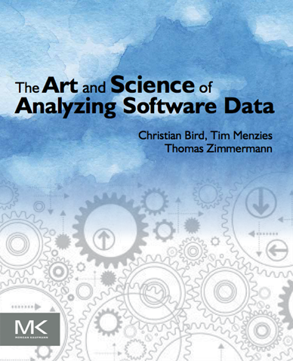
Me
Full Prof in CS NC State. Teaches SE and automated SE.
Researches synergies human+AI, with focus on data mining for SE.
editor of IEEE Transactions on SE, Empirical SE, the Automated SE Journal and Software Quality Journal
Was co-PC-chair for ASE’12, ICSE'15 NIER track.
Will be co-general chair of ICMSE'16.
Author of 230+ referred pubs. One of the 100th most cited authors in SE (out of over 80,000 http://goo.gl/BnFJs). Been PI for NSF, NIJ, DoD, NASA, USDA, and research work with private companies.
Co-founder of the PROMISE conference series on reproducible experiments in SE. Current curator PROMISE web site, SE research data http://openscience.us/repo .
Vita: http://goo.gl/8eNhYM
Pubs: https://goo.gl/qNQAIq
Home page: http://menzies.us

Slide 4
But before we start….
…. why that roadmap?

Slide 5


Welcome to my “Minority Report”
For the “majority” report
E.g.
Basili: http://goo.gl/iokyyn (how to build and share conclusions?)
Boehm: http://goo.gl/QDzuTU (what trends did we miss?)
Broy: http://goo.gl/r04cpx (SE needs extensive domain models)
For another perspective,
Please stay in your seat

Slide 6
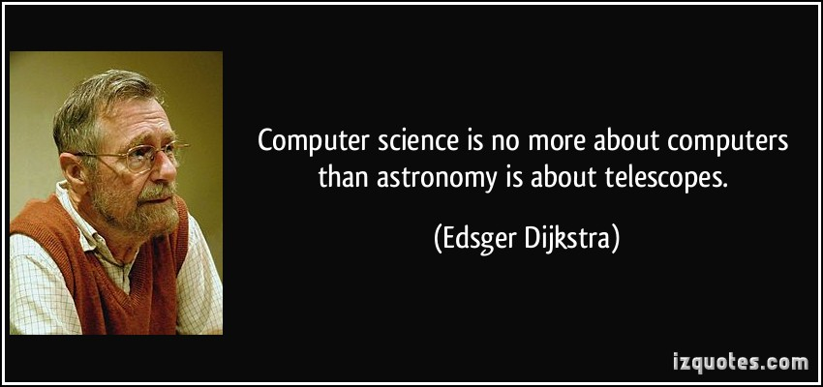
Software engineering researchers just studying software is like astronomers just studying telescopes.
After we grind the lenses, we should look through the scope.
After we build the software, we see how people are using it

Slide 7
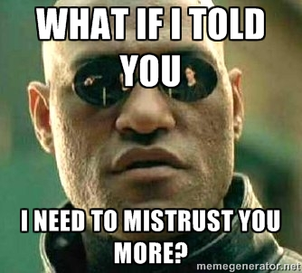
Software tools for “citizen scientists”
Science has escaped the lab and is roaming free in the world.
People use software to understand the world
What tools are needed to support that work?
Want to mistrust the conclusions of the citizen scientists
Just as we mistrust and evaluate, review, explore, evolve the conclusions of any other scientist.

Slide 8
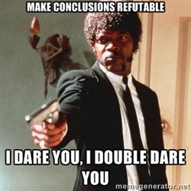
When every citizen can be a scientist (making generalizations from data)
It should be possible to for everyone else to
audit a conclusion;
to repeat (at least in part) the processes that lead to that conclusion;
to reconsider parts of old conclusions;
to decide what a conclusion from some other site does/does not apply locally.

Slide 9
Q: But is this an SE issue?
A: Yes

Slide 10
Confucius: “Study the past if you would define the future”
History of SE
X is not part of SE
People are having trouble with X
Experiments: Extend SE to include X
Conclusion: “you know what? SE tool support makes X easier”

Slide 11
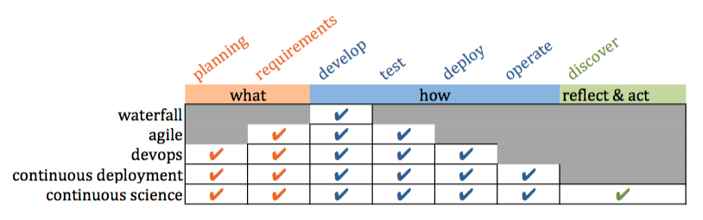
Confucius: “Study the past if you would define the future.”
History of SE
X is not part of SE
People are having trouble with X
Experiments: Extend SE to include X
Conclusion: “you know what? SE tool support makes X easier”

Slide 12
Confucius: “Study the past if you would define the future.”
Future of SE
Software mediates what we see and how we act in the world
Everyone with software is now a scientist
Software supports communities as they judge conclusions

Slide 13
To find the future, extrapolate the past
Future of SE
Software mediates how everyone sees and acts on the world
Everyone with software is now a scientist
Software supports communities as they judge conclusions

Slide 14
Is my perspective right? (or useful)?
Yes, if I can show:
Increasing use of “discover” software tools
Systematic errors in the “discover” software
Next gen software tools to reduce those errors
Prelim results

Slide 15
Is my perspective right? (or useful)?
Yes, if I can show:
Increasing use of “discover” software tools
Systematic errors in the “discover” software
Next gen software tools to reduce those errors
Prelim results

Slide 16
Is my perspective right? (or useful)?
Yes, if I can show:
Increasing use of “discover” software tools
Systematic errors in the “discover” software
Next gen software tools to reduce those errors
Prelim results
prediction | planning | stability checks | contexts/clustering/customization | optimi- zation | certification envelopes | compression
privacy | anomaly detectors | sharing | pollution markers | repair operators | streaming

Slide 17

Is my perspective right? (or useful)?
Yes, if I can show:
Increasing use of “discover” software tools
Systematic errors in the “discover” software
Next gen software tools to reduce those errors
Prelim results
prediction | planning | stability checks | contexts/clustering/customization | optimi- zation | certification envelopes | compression
privacy | anomaly detectors | sharing | pollution markers | repair operators | streaming

Slide 18
Roadmap
Increasing use of “discover” software tools
Systematic errors in the “discover” software
Next gen software tools to reduce those errors
Prelim results

Slide 19
Roadmap
Increasing use of “discover” software tools
Systematic errors in the “discover” software
Next gen software tools to reduce those errors
Prelim results

Slide 20
Software mediates what we see and how we act in the world
Silicon valley developers view every new feature as an experiment, to be tested within some mash up to existing services.
Chemists win Nobel Prize for software simulations of molecules at various scales http://goo.gl/Lwensc
Engineers use software to tune systems as diverse as optical tweezers, radiation theory, microbiological exposure assessment, remote sensing, and silicon chips; http://goo.gl/qBMyIZ
Web analysts use software to analyze clickstream data to decide how to improve sales and marketing strategies; http://goo.gl/b26CfY

Slide 21
Software mediates what we see and how we act in the world
Algorithmic traders write software to prototype and simulate trading strategies on finance data; http://www.quantopian.com
Analysts write software to mine labor statistics data to predict the merits of proposed government policies http://goo.gl/X4kgnc
Journalists use software to analyze economic data and make visualizations their news stories http://fivethirtyeight.com
If you live in London or New York and need to call an ambulance, that ambulance is waiting for your call at a location pre-determined by a software model http://goo.gl/8SMd1p

Slide 22
Software mediates what we see and how we act in the world
If you cross from Mexico to Arizona, biometrics software decides if you need secondary screening http://goo.gl/Zk8IW4
The power to make your toast comes from a genera tor that was spun-up in response to software predicting your future electrical demands http://goo.gl/bfAiOR
If you fly a plane, software controls many aspects of flight, including what to do in emergency situations http://goo.gl/ocw6zj
If you have a heart attack, the software in the defibrillator will decide how to shock your heart and lungs so that you might live a little longer http://goo.gl/wxaikf

Slide 23
Software mediates what we see and how we act in the world
etc
etc
etc
etc
etc
etc
etc
etc
etc
etc
etc
etc
etc
etc
etc
etc
etc
etc

Slide 24
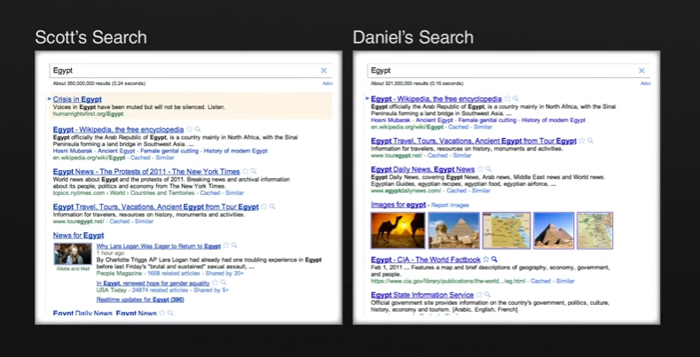
Software divides us
See also “Facebook emotion study breached ethical guidelines, researchers say” June 30, 2014, The Guardian http://goo.gl/gTRkmp

Slide 25
Roadmap
Increasing use of “discover” software tools
Systematic errors in the “discover” software
Next gen software tools to reduce those errors
Prelim results

Slide 26
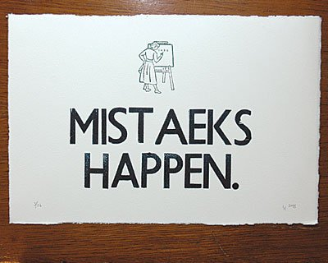
Inevitable, due to the complexity &novelty of our work
(But rarely reported, which is…. suspicious)

Slide 27
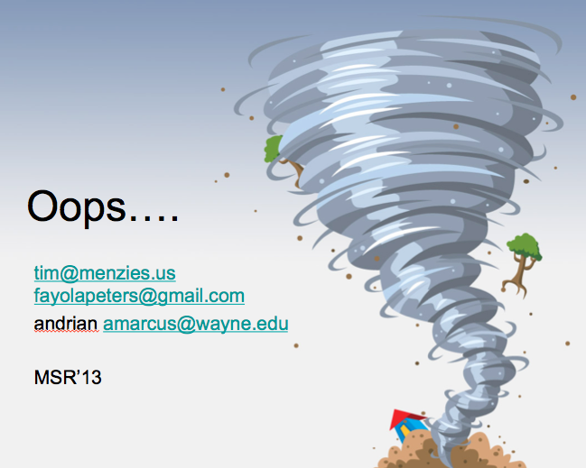
e.g. Houston, we have a problem
Mar 15: paper accepted to MSR
“Better cross-company defect prediction”
Mar 29: camera-ready submitted,
?Apr 10: pre-prints go on-line
April 29: Hyeongmin Jeon, graduate student at Pusan Natl. Univ.,
Emailed us: can’t reproduce result
May 4: Peters, checking code, found error
Manic week of experiments ….
May11: results definitely wrong
Emails to MSR organizers
Our punishment? Present the paper and its error
Btw, < 3 weeks. Wow…

Slide 28
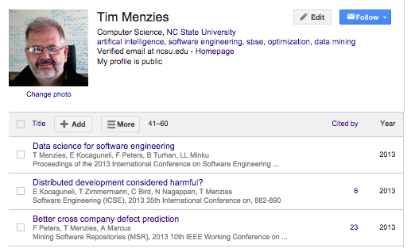
BTW, that paper is still on-line (and when cited, errors not mentioned)
Mechanisms for retraction?

Slide 29
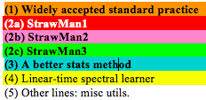
Code used in my last paper (1100 LOC of Python calling scikitlearn)

Slide 30
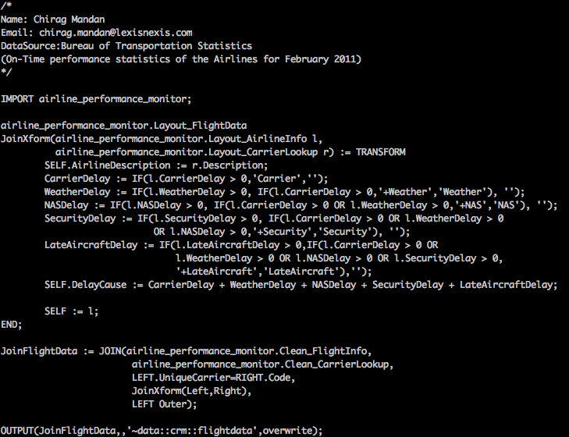
Use a Higher-Level languages?
ECL: a higher-level set-based language (more succinct)
But if you can write it quick,
you can write it wrong, quick.
Implications for
markets, ambulances, government policies, homeland security, toasters. Air safety, Nobel prizes, web-company advertising polices, do we take the family to Cairo for a holiday, etc etc

Slide 31
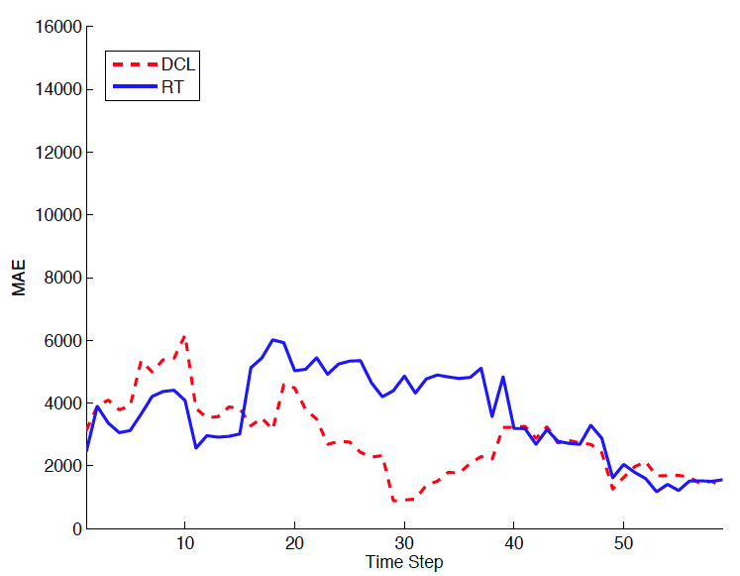
The acid test: Are we planning for the variability of our conclusions?
Devanbu et al. ASE’11 Ecological Inference
Betternburg et al. MSR’12 Think local, act global,
Menzies et al. TSE’13 Local versus Global learning,
Yang et al. IST’13 Handling local bias,
Minku et al. ICSE’14 Best Use of Cross-Company Data
Using ensemble data
Using local data
Error (less is better)

Slide 32
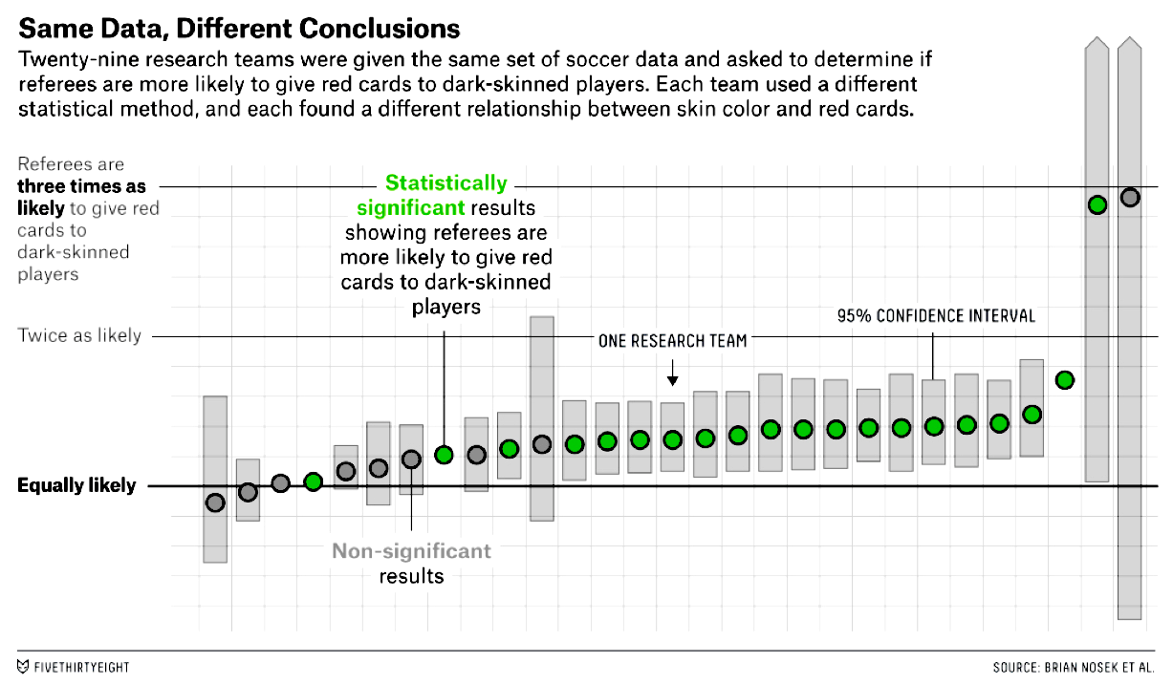
http://fivethirtyeight.com/features/science-isnt-broken/

Slide 33
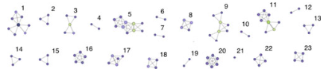
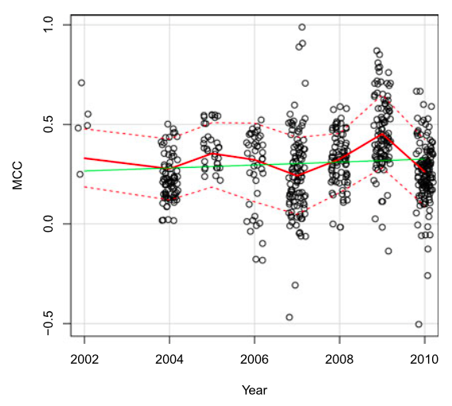
Researcher Bias: The Use of Machine Learning in Software Defect Prediction, Martin Shepperd, David Bowes, and Tracy Hall, IEEE TRANS on Soft. Eng. , 40(6), JUNE 2014
Software analytics
Defect prediction
Many of the same learners,
Many of the same data sets
42 papers, top journals,
23 author groups
2002 to 2010
Y-axis measures mean performance

Slide 34
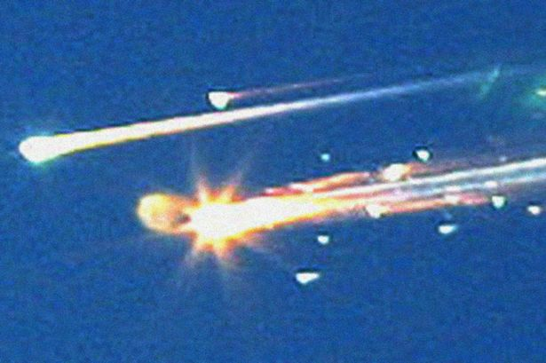
How a software model killed the space shuttle
Columbia ice strike
Size: 1200 m²
Speed: 477 mpg (relative to vehicle)
Certified as “safe” by the CRATER micro-meteorite model.
A experiment in CRATER’s DB:
Size: 3cm³
Speed: under 100 mpg
Columbia’s crew burns up on re-entry
Lesson: conclusions should come with a “certification envelope”
If new tests outside of the envelope of the training set
Raise an alert

Slide 35
The over storage problem
Facebook, Google, Netflix etc

Slide 36
Roadmap
Increasing use of “discover” software tools
Systematic errors in the “discover” software
Next gen software tools to reduce those errors
Prelim results

Slide 37
This talk
What is search-based SE?
Why use less CPU for SBSE?
How to use less CPU
Refactor the optimizer:
Add in some data mining
Experimental results
Related Work
Future work
A challenge question:
Are we making this too hard?
ai4se.net

Slide 38
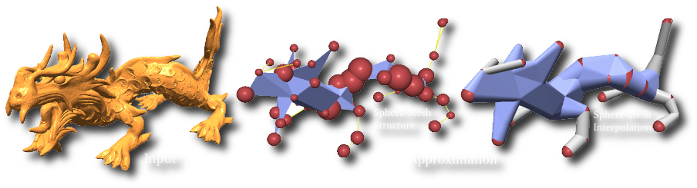
When searching for solutions “you don’t need all that detail”
In Computer
Graphics
In Machine learning
In Theorem proving
In Software Eng.
Variable subset selection (Kohavi, 1997)
Instance selection (Chen, 1975)
Active learning
Narrows (Amarel, 1986)
Master variables (Crawford 1995)
Back doors (Selman 2002).
Saturation in mutation testing (Budd, 1980 and many others

Slide 39
This talk
What is search-based SE?
Why use less CPU for SBSE?
How to use less CPU
Refactor the optimizer:
Add in some data mining
Experimental results
Related Work
Future work
A challenge question:
Are we making this too hard?
ai4se.net

Slide 40
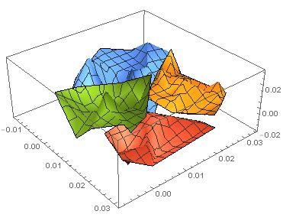
How to use less CPU (for SBSE)
Objectives = evaluate(decisions)
Generations *( Selection + Evaluation * Generation)
G * ( O(N²) + E * O(1)*N )
ai4se.net

Slide 41
How to use less CPU (for SBSE)
Objectives = evaluate(decisions)
Generations * (Selection + Evaluation * Generation)
G * ( O(N²) + E * O(1)*N )
Approximate the space
k=2 divisive clustering
ai4se.net

Slide 42
How to use less CPU (for SBSE)
Objectives = evaluate(decisions)
Generations * (Selection + Evaluation * Generation)
G * ( O(N²) + E * O(1)*N )
Approximate the space
k=2 divisive clustering
(X,Y)= 2 very distant points in O(2N)
ai4se.net

Slide 43
How to use less CPU (for SBSE)
Objectives = evaluate(decisions)
Generations * (Selection + Evaluation * Generation)
G * ( O(N²) + E * O(1)*N )
Approximate the space
k=2 divisive clustering
(X,Y)= 2 very distant points in O(2N)
Evaluate only (X,Y)
ai4se.net

Slide 44
How to use less CPU (for SBSE)
Objectives = evaluate(decisions)
Generations * (Selection + Evaluation * Generation)
G * ( O(N²) + E * O(1)*N )
Approximate the space
k=2 divisive clustering
(X,Y)= 2 very distant points in O(2N)
Evaluate only (X,Y)
If better(X,Y)
If size(cluster) > sqrt(N)
Split, recurse on better half
E.g. cull red
Else, push points towards X
E.g. push orange
ai4se.net

Slide 45
How to use less CPU (for SBSE)
Objectives = evaluate(decisions)
Generations * (Selection + Evaluation * Generation)
G * ( O(N²) + E * O(1)*N )
Approximate the space
k=2 divisive clustering
(X,Y)= 2 very distant points in O(2N)
Evaluate only (X,Y)
If better(X,Y)
If size(cluster) > sqrt(N)
Split, recurse on better half
E.g. cull red
Else, push points towards X
E.g. push orange
Red is culled
ai4se.net

Slide 46
How to use less CPU (for SBSE)
Objectives = evaluate(decisions)
Generations * (Selection + Evaluation * Generation)
G * ( O(N²) + E * O(1)*N )
Approximate the space
k=2 divisive clustering
(X,Y)= 2 very distant points in O(2N)
Evaluate only (X,Y)
If better(X,Y)
If size(cluster) > sqrt(N)
Split, recurse on better half
E.g. cull red
Else, push points towards X
E.g. push orange
e.g. orange points get pushed this way
Red is culled
ai4se.net

Slide 47
How to use less CPU (for SBSE)
Objectives = evaluate(decisions)
Generations * (Selection + Evaluation * Generation)
G * (O(N²) + E * O(1)*N)
Approximate the space
k=2 divisive clustering
(X,Y)= 2 very distant points in O(2N)
Evaluate only (X,Y)
If better(X,Y)
If size(cluster) > sqrt(N)
Split, recurse on better half
E.g. cull red
Else, push points towards X
E.g. push orange
g * ( O(N) + log( E * O(1) * N))
e.g. orange points get pushed this way
Red is culled
ai4se.net

Slide 48
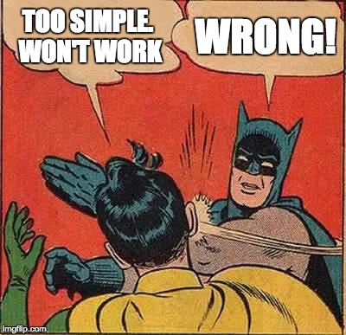

Slide 49
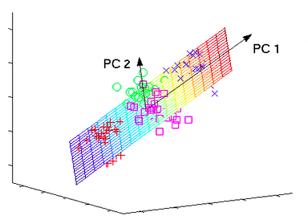
GALE’s clustering = fast analog for PCA (so GALE is a heuristic spectral learner)
ai4se.net
49

Slide 50
This talk
What is search-based SE?
Why use less CPU for SBSE?
How to use less CPU
Refactor the optimizer:
Add in some data mining
Experimental results
Related Work
Future work
A challenge question:
Are we making this too hard?
ai4se.net
50

Slide 51
Sample models
Benchmark suites (small)
SE models
The usual suspects: goo.gl/FTyhkJ
2-3 line equations
Fonseca, Schaffer, woBar. Golinski,
Also, from goo.gl/w98wxu
The ZDT suite :
The DTLZ suite
On-line at: goo.gl/nv2AVK
XOMO: goo.gl/tY4nLu COCOMO software effort estimator + defect prediction + risk advisor
POM3: goo.gl/RMxWC Agile teams prioritizing tasks
Tasks costs and utility may subsequently change
Teams depend on products from other teams
Internal NASA models:
CDA: goo.gl/wLVrYA
NASA’s requirements models for human avionics

Slide 52
Comparison algorithms
What we used (in paper)
Since paper
NSGA-II (of course)
SPEA2
Selected from Sayyad et al’s ICSE’13 survey of “usually used MOEAs in SE”
Not IBEA:
BTW, I don’t like IBEA, just its continuous domination function
Used in GALE
Differential evolution
MOEA/D
?NSGA III
Some quirky “bunching problems”

Slide 53
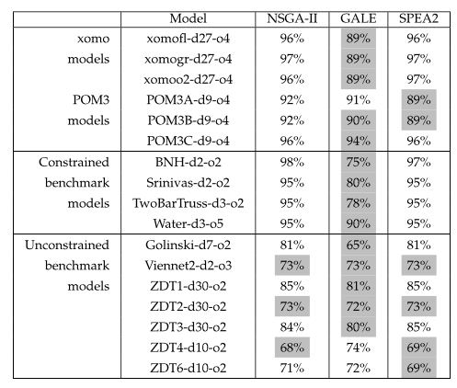
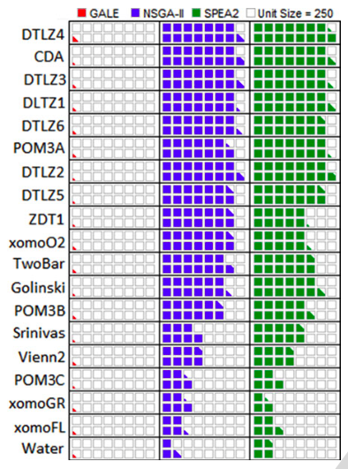
GALE: one of the best, far fewer evals
Gray: stats tests: as good as the best
ai4se.net

Slide 54
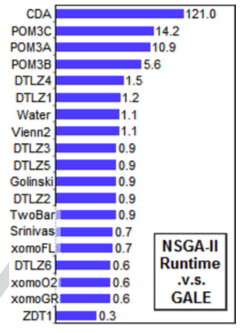
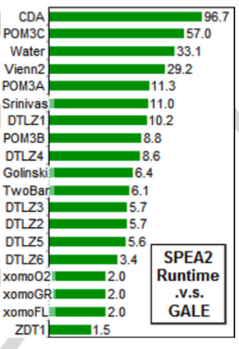
For small models, not much slower For big models, 100 times faster
ai4se.net

Slide 55
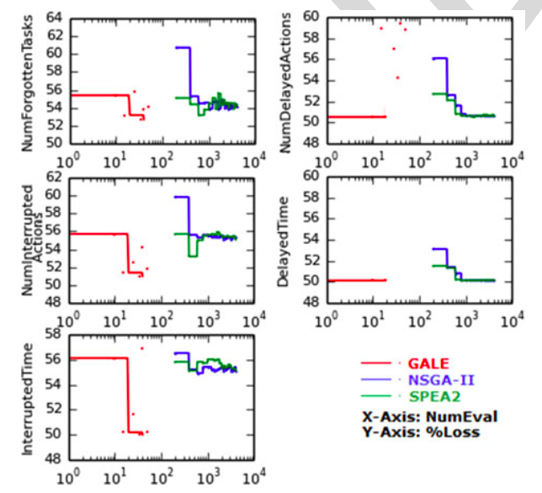
On big models, GALE does very well
NASA’s requirements models for human avionics
• GALE: 4 mins
• NSGA-II: 8 hours
ai4se.net

Slide 56
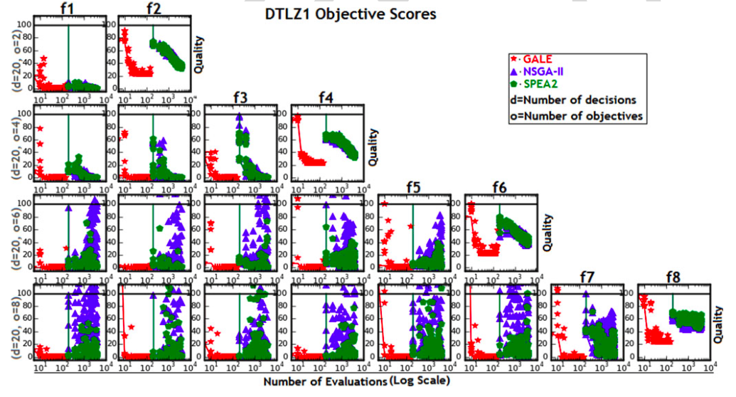
DTLZ1:from 2 to 8 goals
ai4se.net

Slide 57
This talk
What is search-based SE?
Why use less CPU for SBSE?
How to use less CPU
Refactor the optimizer:
Add in some data mining
Experimental results
Related Work
Future work
A challenge question:
Are we making this too hard?
ai4se.net

Slide 58
Related work (more)
[X] = reference
in paper
Active learning [8]
Don’t evaluate all,
Just the most interesting
Kamvar et al. 2003 [33]
Spectral learning
Boley , PDDP 1998 [34]
Classification, recursive descent on PCA component
O(N²), not O(N)
SPEA2, NSGA-II, PSO, DE, MOEA/D, Tabu..
All O(N) evaluations
Various local search methods (Peng [40])
None known in SE
None boasting GALE’s reduced runtimes
Response surface methods Zuluaga [8]
Parametric assumptions about Pareto frontier
Active learning

Slide 59
This talk
What is search-based SE?
Why use less CPU SBSE?
How to use less CPU
Refactor the optimizer:
Add in some data mining
Experimental results
Related Work
Future work
A challenge question:
Are we making this too hard?
ai4se.net

Slide 60
Future work
More Models
More Tool Building
Siegmund & Apel’s runtime configuration models
Rungta’s NASA models of space pilots flying MARS missions
100s of Horkoff’s softgoal models
Software product lines
Explanation systems
Complex MOEA tasks solved by reflecting on only a few dozen examples
Human in the loop guidance for the inference?
There remains one loophole GALE did not exploit
So after GALE comes STORM,
Work in progress

Slide 61
This talk
What is search-based SE?
Why use less CPU for SBSE?
How to use less CPU
Refactor the optimizer:
Add in some data mining
Experimental results
Related Work
Future work
A challenge question:
Are we making this too hard?
ai4se.net

Slide 62
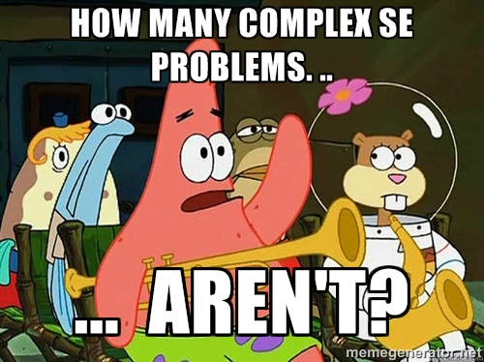
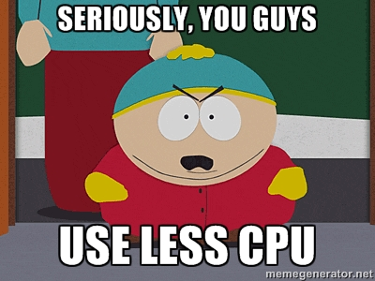

Slide 63
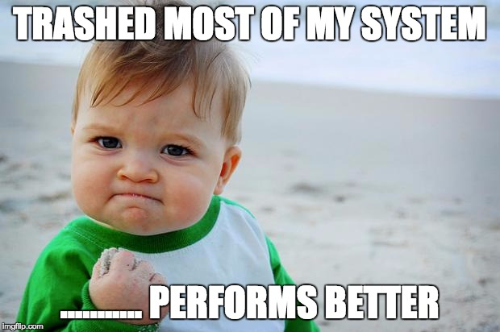
GALE’s dangerous idea
Simple approximations exist for seemingly complex problems.
Researchers jump to the complex before exploring the simpler.
Test supposedly sophisticated vs simpler alternates (the straw man).
My career: “my straw don’t burn”
ai4se.net

Slide 65
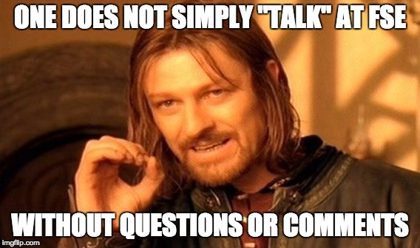
Slides: tiny.cc/gale15
Software: tiny.cc/gale15code
ai4se.net

